Slide 1




https://trainity.in/data.html
Real-life Example of Data Analytics Process in E-commerce
NOTE : The primary reason I chose this example is that I'm already familiar with it from my two projects—the first is in e-commerce, and the other is advanced e-commerce.
cocsamcoc69@gmail.com
https://www.linkedin.com/in/suraj-kumar-950795222/

Slide 2
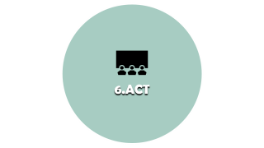

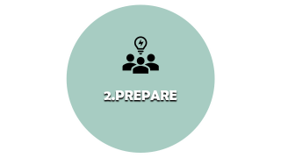
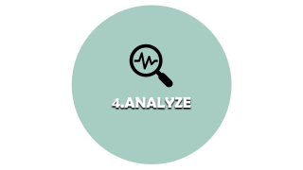

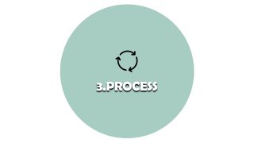

Scenario
An e-commerce company aims to enhance customer experience and increase sales through data-driven strategies.

Slide 3

1.PLAN

Slide 4

https://trainity.in/data.html
PLAN
The company plans to utilize data analytics to understand customer behavior, personalize marketing efforts, and optimize the online shopping experience.
cocsamcoc69@gmail.com
https://www.linkedin.com/in/suraj-kumar-950795222/

Slide 5

2.PREPARE

Slide 6
https://trainity.in/data.html
PREPARE
Data Collection:
Collecting information from a range of sources, such as marketing campaign,
purchase histories,
website interactions, and customer demographics.
Data Cleaning
Cleansing and consolidating the collected data to ensure accuracy and consistency.
cocsamcoc69@gmail.com
https://www.linkedin.com/in/suraj-kumar-950795222/

Slide 7

3.PROCESS

Slide 8
https://trainity.in/data.html
PROCESS
Data Integration:
Integrating data from multiple sources to create a unified customer and sales dataset.
Data Transformation:
Converting raw data into a structured format suitable for analysis.
. Data Security:
Ensuring the security and privacy of customer data in compliance with regulations.
cocsamcoc69@gmail.com
https://www.linkedin.com/in/suraj-kumar-950795222/

Slide 9

4.ANALYZE

Slide 10
https://trainity.in/data.html
ANALYZE
Customer Segmentation:
Analyzing customer data to identify segments based on preferences, purchasing behavior, and demographics.
Personalized Recommendations:
Using data to provide personalized product recommendations and targeted marketing campaigns.
Shopping Pattern Analysis:
Analyzing browsing and purchase patterns to optimize website layout and product placement.
cocsamcoc69@gmail.com
https://www.linkedin.com/in/suraj-kumar-950795222/

Slide 11

5.SHARE

Slide 12
https://trainity.in/data.html
SHARE
Marketing Insights:
Sharing insights with the marketing team to tailor campaigns and promotions based on customer segments.
User Experience Optimization:
Collaborating with web developers to enhance the online shopping experience based on data-driven insights.
cocsamcoc69@gmail.com
https://www.linkedin.com/in/suraj-kumar-950795222/

Slide 13

6.ACT

Slide 14
https://trainity.in/data.html
ACT
Personalized Marketing Campaigns:
Implementing targeted marketing campaigns based on customer segments and preferences.
Website Optimization:
Utilizing insights to optimize the website layout, product recommendations, and checkout process.
Monitoring and Feedback:
Continuously monitoring the impact of changes and gathering customer feedback for further improvements.
cocsamcoc69@gmail.com
https://www.linkedin.com/in/suraj-kumar-950795222/

Slide 15

7. Conclusion

Slide 16
https://trainity.in/data.html
Conclusion
Through the data analytics process, the e-commerce company can improve customer engagement, increase sales, and create a more personalized and optimized shopping experience for its customers.
cocsamcoc69@gmail.com
https://www.linkedin.com/in/suraj-kumar-950795222/

Slide 17
THANK YOU
:-SURAJ KUMAR

